Slide 1


<MagB>
<May 2023>

Slide 2

Outline
Executive Summary
Introduction
Methodology
Results
Conclusion
Appendix

Slide 3
Executive Summary
Summary of methodologies
Data collection using API
Data collection with web scraping
Data wrangling
Exploratory data Analysis with SQL
Exploratory data Analysis with Data Visualization
Interactive Visual Analytics with Folium
Machine learning prediction
Summary of all results
EDA results
Interactive and predictive analysis results

Slide 4
Introduction
Project background and context
A new rocket company is trying to determine what are the success factors for SpaceX launch and if SpaceX will reuse the first stage.
In order to study these points, we will use and train a machine learning model, with public informations.
The outcome of this study can be further use to determine the cost of a launch for alternate company.
Problems
Which features/conditions contribute to the success of the launching (payload, orbit, launch site…)
What is the trend of the success rate over time?
What is the most reliable machine learning model to determine the success of a launch?

Slide 5

Section 1

Slide 6
Methodology
Executive Summary
Data collection
2 sources for data :
SpaceX API : (https://api.spacexdata.com/v4/rockets/)
Webscraping from Wikipedia : (https://en.wikipedia.org/wiki/List_of_Falcon_9_and_Falcon_Heavy_launches)
Data wrangling
Data cleaning before analysis (replace null value by the mean)
Exploratory data analysis (EDA) using visualization and SQL
Interactive visual analytics using Folium and Plotly Dash
Predictive analysis using classification models
Finding out the best machine learning model with the best accuracy

Slide 7
Data Collection – Space X API
Stage 1
Stage 2
Input the url of the data to analyse
Use the GET request to get and parse the data for SpaceX launch
Convert the response into a JSON file, then in Panda dataframe
Export information about the launches with API
Filter only on Falcon 9 input
Excecute Data cleaning and replace null value
Git hub link : https://github.com/coockiem/Capstone_project_SpaceX_MB/blob/main/Notebook%20Jupyter%201%20Data%20collection.ipynb

Slide 8
Data Collection – Web Scraping
Request the Facon 9 wiki page
Create a Beautiful Soup object
Extract all columns names from the table HTML
Create a empty dictionnay with the columns names
Fill the dictionnary with launch input
Turn the dictionnary into csv dataset
Git hub link: https://github.com/coockiem/Capstone_project_SpaceX_MB/blob/main/Notebook%20jupyter%202%20Web%20scraping.ipynb

Slide 9
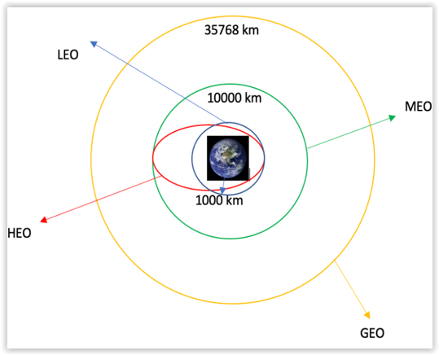
Data Wrangling
Calculate de number of launches for each site
Calculate the number of occurrences for each orbit
Calculate the number of occurrences for mission outcome/orbit type
Create a landing outcome label
Calculate the workout succès rate for every launching in dataset
Git hub link: https://github.com/coockiem/Capstone_project_SpaceX_MB/blob/main/Notebook%20jupyter%203.%20Data%20wrangling.ipynb

Slide 10
EDA with Data Visualization
The charts used are :
Bar chart: Flight number vs Payload mass/Launch sites/Orbit type
Payload mass vs Orbit type/Launch sites
Scatter plot : success rate per orbit
Line plot : success rate and year
Git hub link : https://github.com/coockiem/Capstone_project_SpaceX_MB/blob/main/Notebook%20jupyter%205%20EDA%20Visualisation.ipynb

Slide 11
EDA with SQL
Summary of SQL query used :
Names of unique launch sites
Display 5 records where launch site begins with “CCA
Total payload mass carried by boosters launched by NASA (CRS)
Average payload mass carried by booster F9 v1.1
Dates for first successful landing in ground pad
Names of the boosters with success in drone ship and payload mass between 4 and 6 Kg
Total number of successful and failure mission outcomes
Name of the booster version which have carried the maximum payload mass (with subquery)
List of failed landing outcomes (drone ship type) or success (group pad key) between 2010-06-04 and 2017-03-20 in descending order
Git hub link : https://github.com/coockiem/Capstone_project_SpaceX_MB/blob/main/Notebook%20jupyter%204%20SQL.ipynb
Git hub link completed EDA with SQL notebook,

Slide 12
Build an Interactive Map with Folium
Markers (for launch sites), lines (for distance) and markers clusters (for events such as launch) were used with Folium map to show the nearest important landmarks such as railways, highways, cities and coastlines.
Draw red line to show rocket launch failures and green lines to show the successes.
Then, using the Haversines formula, calculate the distance from the launch site to the various landmarks
Git hub link : https://github.com/coockiem/Capstone_project_SpaceX_MB/blob/main/Notebook%20jupyter%205%20Visual%20Analytics%20with%20Folium.ipynb

Slide 13
Build a Dashboard with Plotly Dash
Launch records of SpaceX were visualized with Pie Charts and scatters Charts.
We display the rocket launch success rate per site to understand which factors may influence the success rate on each site.
We try to understand the correlation between factors like payload mass and launch site.
Successful launches are represented by a “1” and failures by a “0”.

Slide 14
Predictive Analysis (Classification)
We use Scikit-learn for predictive analysis (evaluate the success chance of landing at first stage)
4 classifications models were compared (logistic regression, SVM, Decision tree, K nearest neighbours)
Load dataframe
Transform the data
Split the data into training and test set
Find the best parameters with GridSearchCV object
Calculate the accuracy on test data
Choose the best ML model
Compare Predictions vs Actuals (use confusion matrix)
Improve the model and selection of best model
Git hub link: https://github.com/coockiem/Capstone_project_SpaceX_MB/blob/main/Notebook%20jupyter%206%20Machine%20learning.ipynb

Slide 15
Results
Exploratory data analysis results
There are 4 different launch sites with different success rate. The best sites are located near the coastline (probably for safety reason), and not too far from transportations infrastructures such as highway and railways (make easier transportations of people and materials)
First success appears to be in 2015
The average payload is 2928 kg
2 failures occurred with the booster version FXXXXX in 2015
The rate of success increase as years passed.
Predictive analysis results
The machine learning model was able to predict the landing success of rockets with an accuracy of 88%

Slide 16

Section 2

Slide 17
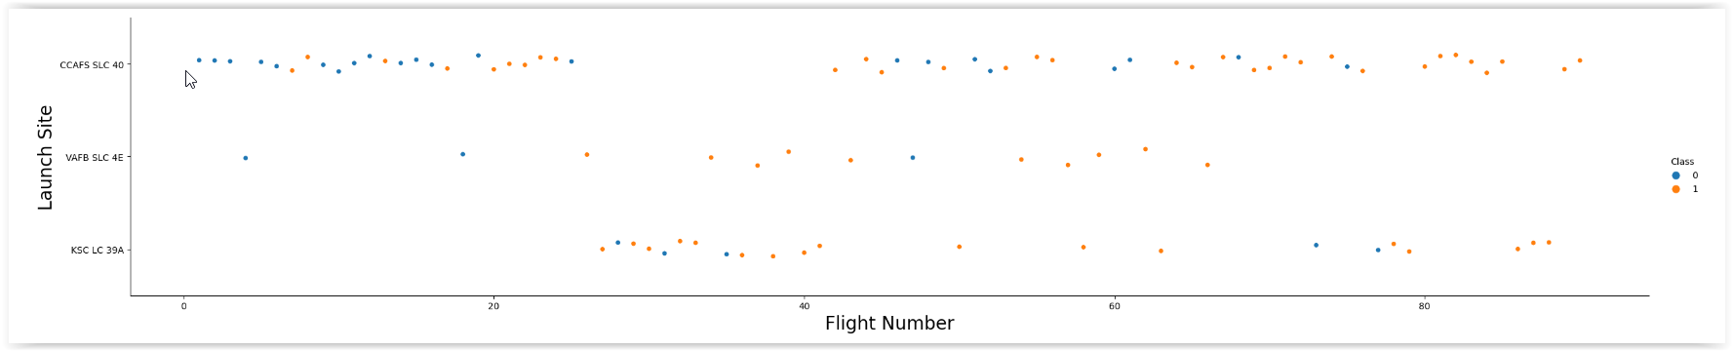
Flight Number vs. Launch Site
It appears clearly that most successful landing took off from CCAFS sites, but also from KSC site, although the first flights were less successful.
The success increases with the number of flights.

Slide 18
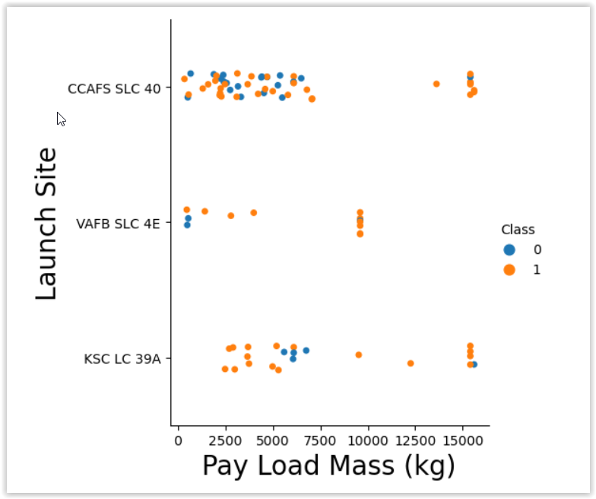
Payload vs. Launch Site
Only 2 sites allows the comparison for heavy payload (> 10K Kg).
It seems that success launches are higher when payload is > 10K Kg.
However, it would be surprinsing to find that there is a clear connection between launch sites and payload.

Slide 19
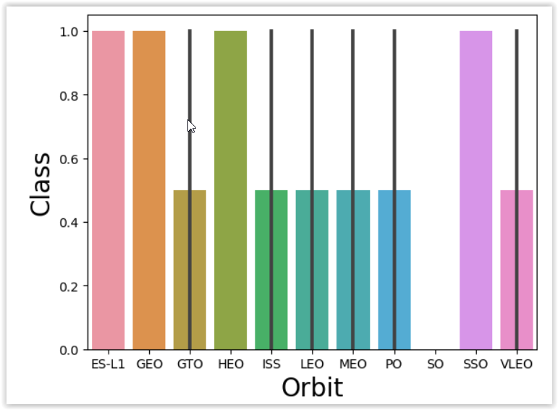
Success Rate vs. Orbit Type
There is a 100% success rate for ORBITS below :
ES-L1
GEO
SSO
HEO
We can notice that SO orbit has a success rate of 0% (but with only 1 launch).

Slide 20
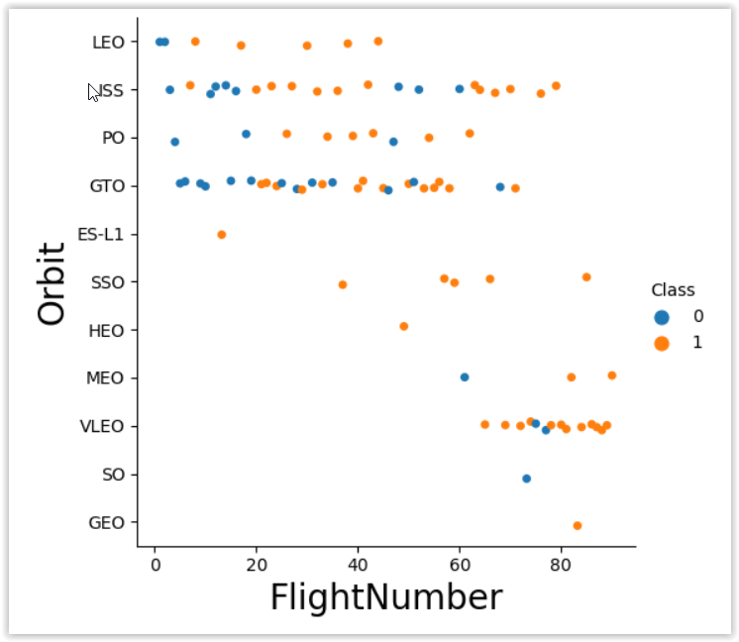
Flight Number vs. Orbit Type
It seems that LEO and PO orbits have an increasing success rate with the number of flights.
Some orbits have very few flights (Ex: VLEO) so it is difficult to compare with others.

Slide 21
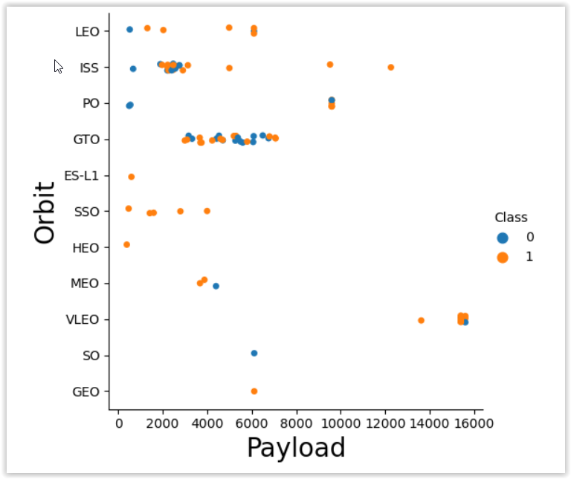
Payload vs. Orbit Type
SSO orbit is 100% successful.
Despite the great number of flight, it is not obvious to state if GTO orbit is successful or not.
We can also see a clear distinction between low and high payload (> 8K Kg) : there are not a lot of flights to compare above this payload mass.

Slide 22
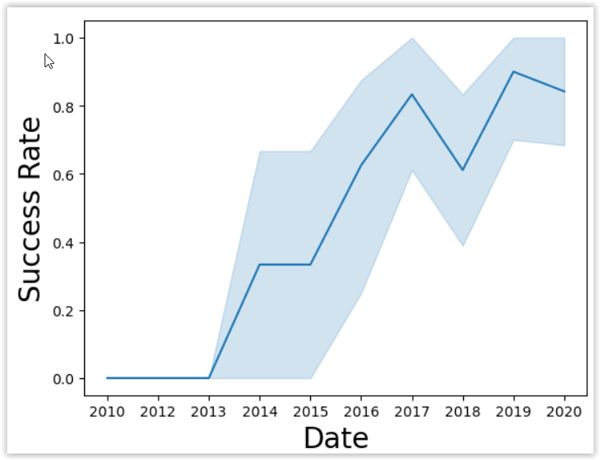
Launch Success Yearly Trend
It is clear that the success rate increases with the year (maybe due to more experiences that make adjustments possible and evolution of technology)

Slide 23
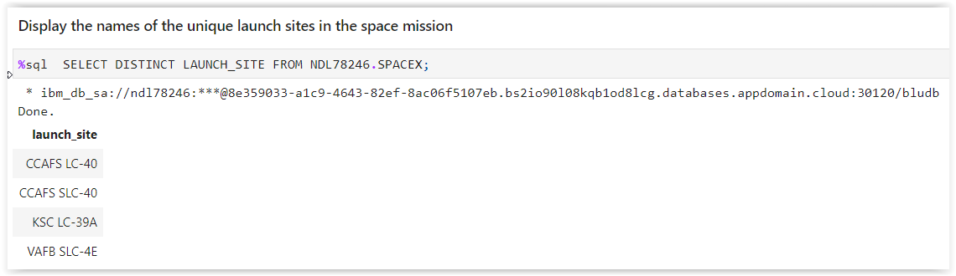
All Launch Site Names
The unique launch sites are listed below :
CCAFS LC-40
CCAFS SLC-40
KSC LC-39A
VAFB SLC-4E
We use the SELECT DISTINCT command to retrieve the unique launch site names

Slide 24
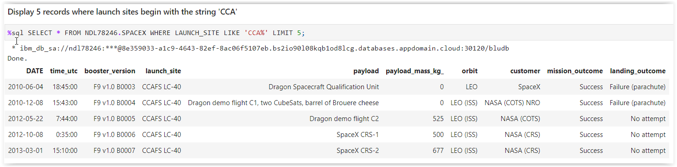
Launch Site Names Begin with 'CCA'
List of 5 records where launch sites begin with `CCA` where we can see other organization than NASA.
We use the LIMIT command to retrieve 5 records only.

Slide 25
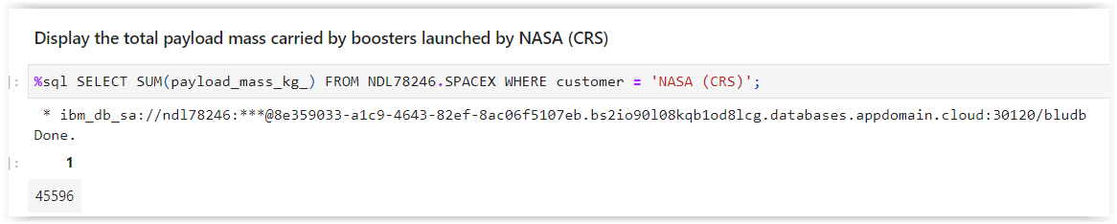
Total Payload Mass
The total payload mass carried by boosters from NASA as customer was 45596 kg
We use the SUM function to calculate the total payload mass and the filter customer = ‘NASA (CRS)’ to calculate NASA only results.

Slide 26
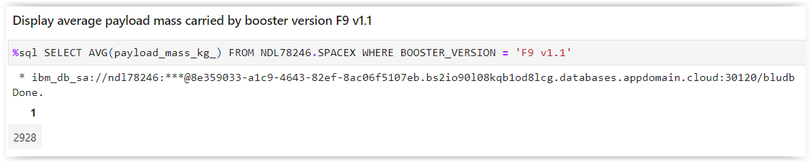
Average Payload Mass by F9 v1.1
The average payload mass carried by booster version F9 v1.1 was 2928,4 Kg
We use the AVG() function to retrieve the average payload mass and the filter Booster version = ‘F9 V1.1’ to calculate result for this booster version only.

Slide 27
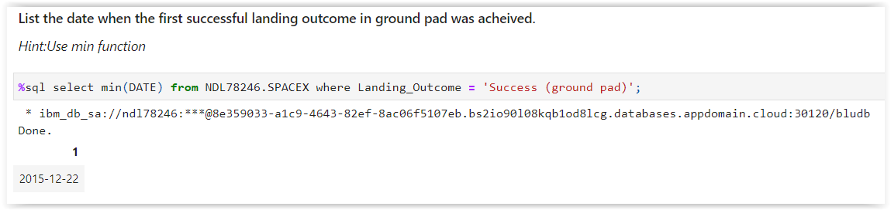
First Successful Ground Landing Date
The date of the first successful landing outcome on ground pad was 22 December 2015.
We use the MIN() function to retrieve the smallest value date, with a filter on landing outcome =‘Success (ground pad)’’.

Slide 28
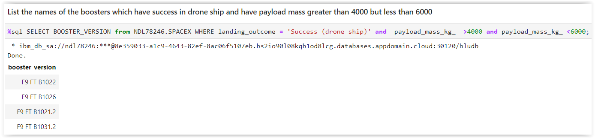
Successful Drone Ship Landing with Payload between 4000 and 6000
There are only 4 boosters with a payload mass between 4K and 6K kg.
We use 2 conditions here to filter the records by landing outcome and payload mass.

Slide 29
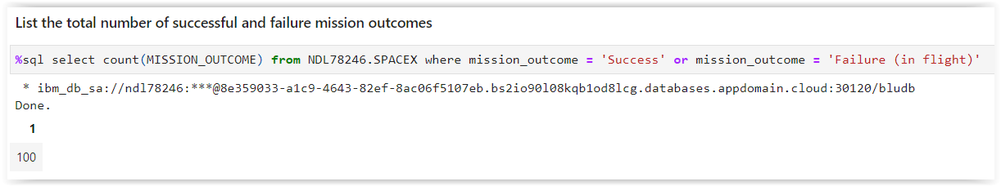
Total Number of Successful and Failure Mission Outcomes
The total number of successful and failure mission outcomes is 100.
We use COUNT() function to retrieve the number of records for mission outcome = ‘Success’ or ‘Failure (in flight)’

Slide 30
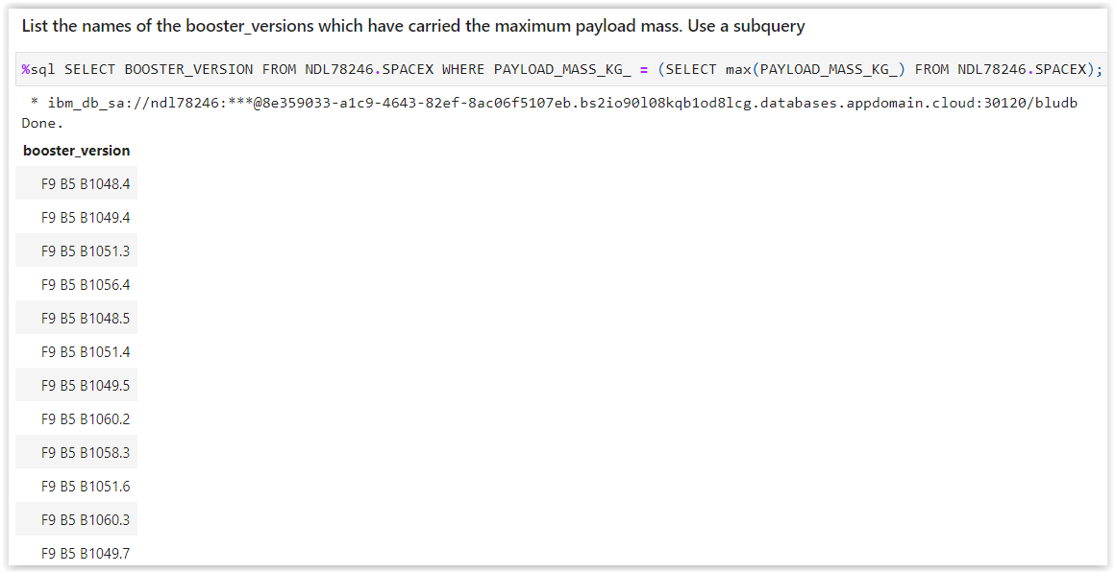
Boosters Carried Maximum Payload
There are 12 boosters which have carried a maximum payload mass of 15600 Kg
We use a sub query to retrieve the maximum payload mass associated to the MAX() function.

Slide 31
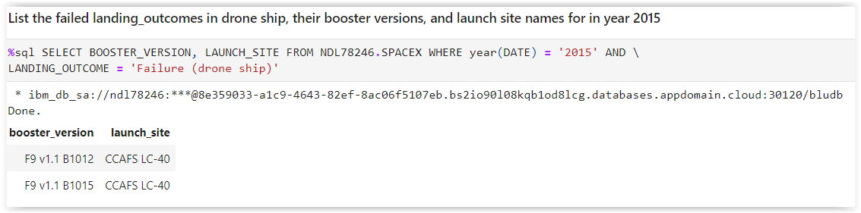
2015 Launch Records
There were 2 boosters (drone ship) that failed to land in 2015, both situated in the launch site CCAFS LC-40 :
F9 v1.B1012
F9 v1.B1015
We use the YEAR() function to retrieve the year part of the date.

Slide 32
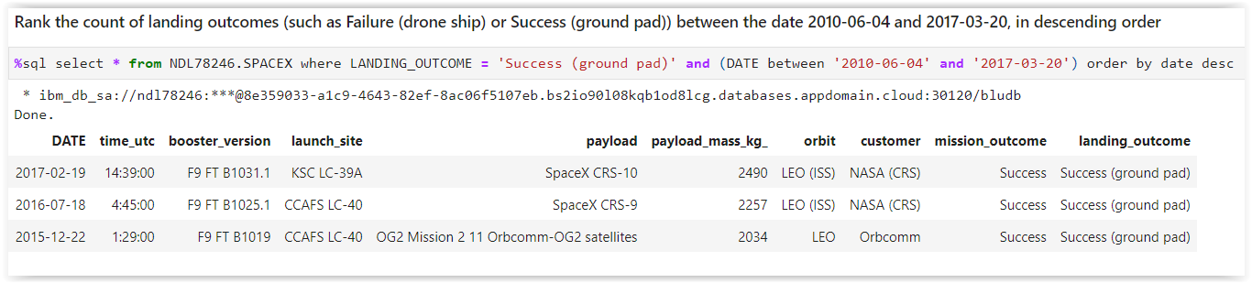
Rank Landing Outcomes Between 2010-06-04 and 2017-03-20
We are ranking the count of landing outcomes (such as Failure (drone ship) or Success (ground pad)) between the date 2010-06-04 and 2017-03-20, in descending order.
We use order by date desc to sort by1st column in descending order

Slide 33

Section 3

Slide 34
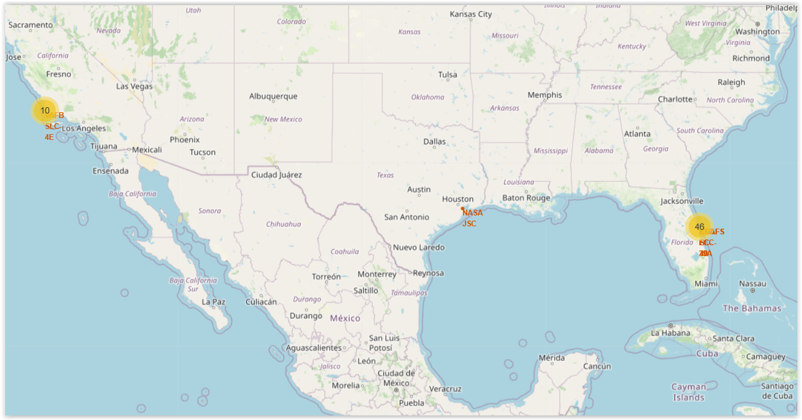
Launch sites
The main lauchsites are opposite to each other, one in Florida (east coast) and the other in California (west coast) to be able to choose the best regarding different factors.
The choice of launch site is very important in order to avoid crash as the one of Starphip in April 2023 and the huge amount of damage caused.

Slide 35
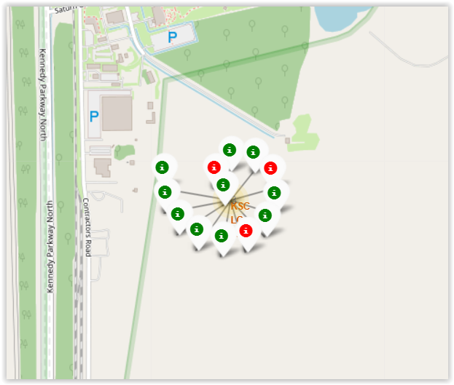
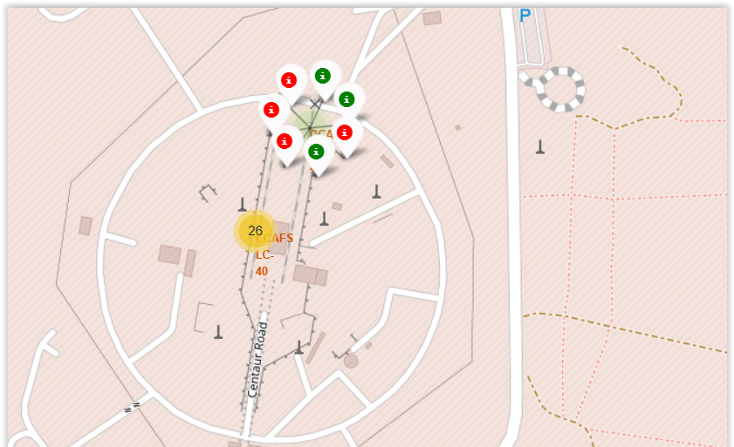
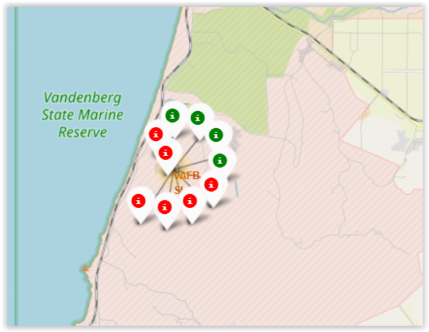
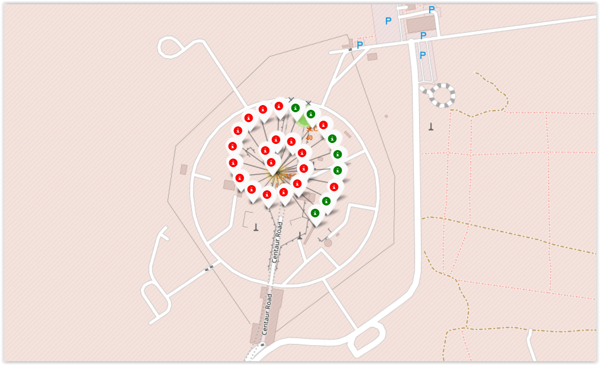
Success rate of launches per site
KSC-LC39A
CCAFS-SLC40
Example for sites CCAFS-SLC40, CCAFS_LC40, VAFB-SLC4E & KSC-LC39A
Green markers indicate success and red ones failures.
We can already noticed that KSC-LC39A seems to have a good ratio (green/red) of successful launches, compared to the others.
VAFB-SLC4E
CCAFS-LC40

Slide 36
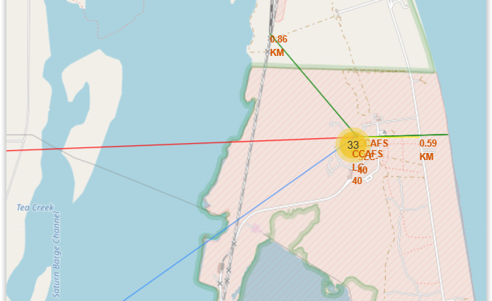
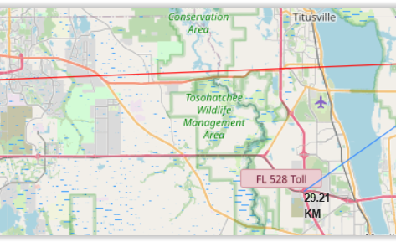
Distance to proximities
Launch sites are located (example for launch site CCAFS-SLC40)
Far from cities for safety (almost 79 Km from Orlando for CCAFS site)
Not too far from highway (29 km) for easy transportation of people/evacuation in case of a incident
Close to railways (0.86 km) for easy logistic
Close to coastline (0.59 km) to avoid damages in case of launch failures

Slide 37

Section 4

Slide 38
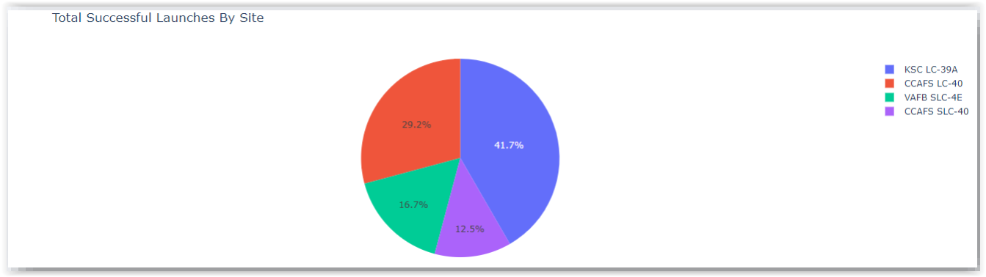
Successful launches by site
The place of launching is a very important factor for success of mission. The majority of launches took place in KSC LC-39A site (41,7%).

Slide 39
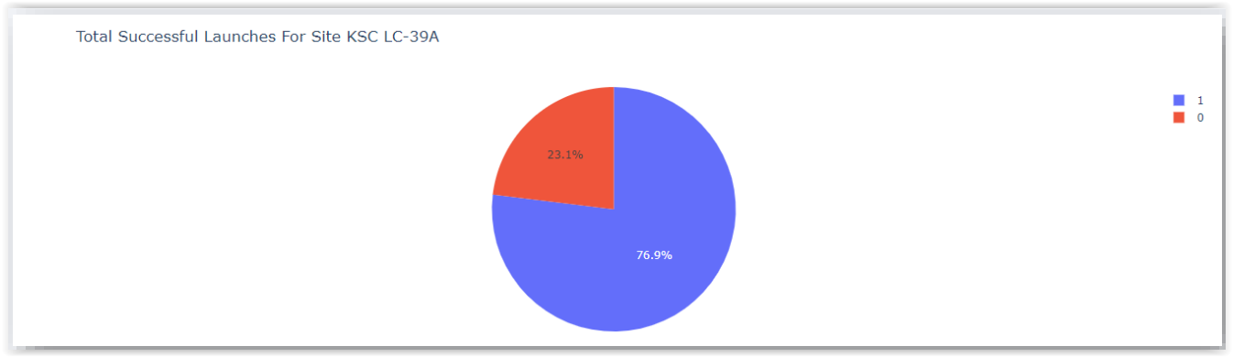
Successful launches by site
The site KSC LC-39A seems to be the most successful with a rate of 76,9% of success, not surprisingly at it was the site with most launches.

Slide 40
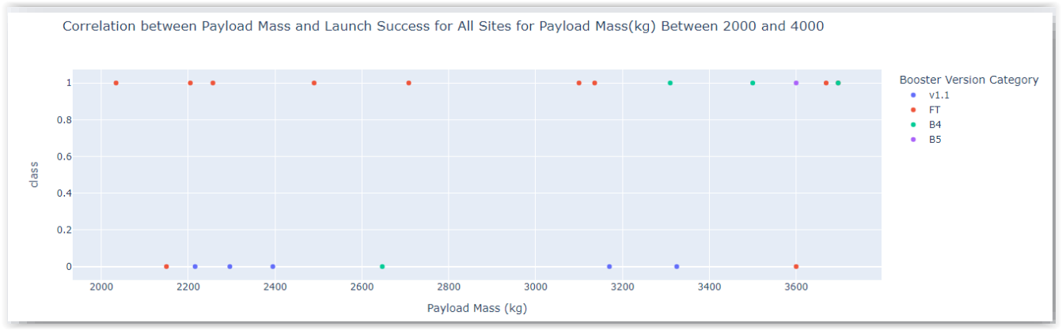
Payload mass vs launch outcome for all site
It appears that lower payload under 4K Kg has the highest success rate if combined with FT boosters.

Slide 41

Section 5

Slide 42
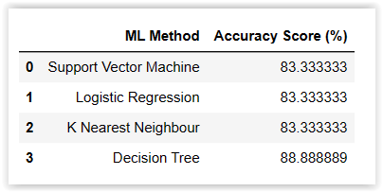
Classification Accuracy
4 classifications models were tested and their accuracy calculated (score method).
The model with the highest accuracy is the decision tree with a rate of 88%.

Slide 43
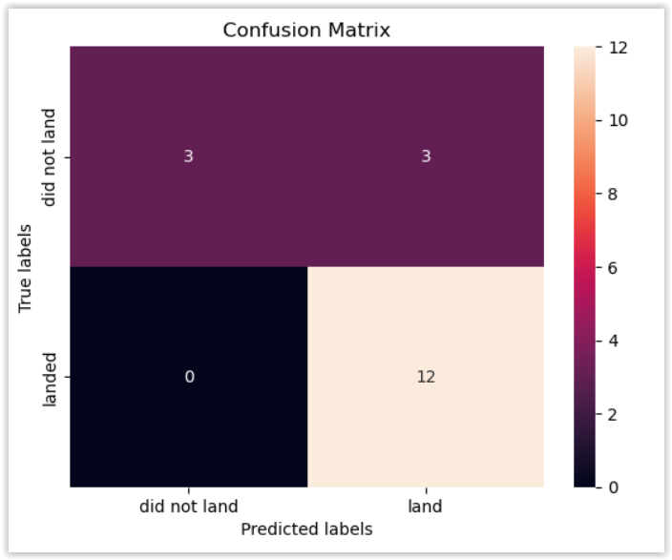
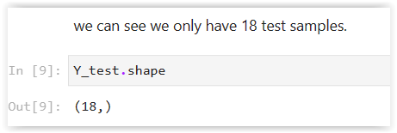
Confusion Matrix
The confusion matrix for decision tree has been plotted for test data. Unfortunately, all the matrix confusion are the same for all models, so not much can be said, except that :
The number of false positive (3) is quite high for such activity as launching rocket, which is a major problem in terms of safety and cost.
Accuracy (correctly classified data) is the same for the 18 tests data for all models (TP+TN/Total = 0.83)

Slide 44
Conclusions
Main findings about factors of success for launching rockets :
The tree classifier has the best accuracy rate (with this dataset) (88%).
The location of launch site is a very important factor and need to be at a fair distance of infrastructures.
Launch site with the highest rate of success (77%) has been found to be KSC LC-39A.
SSO orbit has the highest success rate with GEO and HEO (100%)
Lower payload (<4kg) seems to be more successful than higher payload.
There is a growing trend of success since 2015, as the more launches done, the more improvements are made.

Slide 45


